Slide 1
FPV Racing Drone
Team 64
Group 64
Elias O’Malley, Hunter Baisden, Griffin Descant
Notes:
Hunter: Hello, we are group 64 and our project was to design a FPV drone for the center for autonomy research lab [next slide]

Slide 2
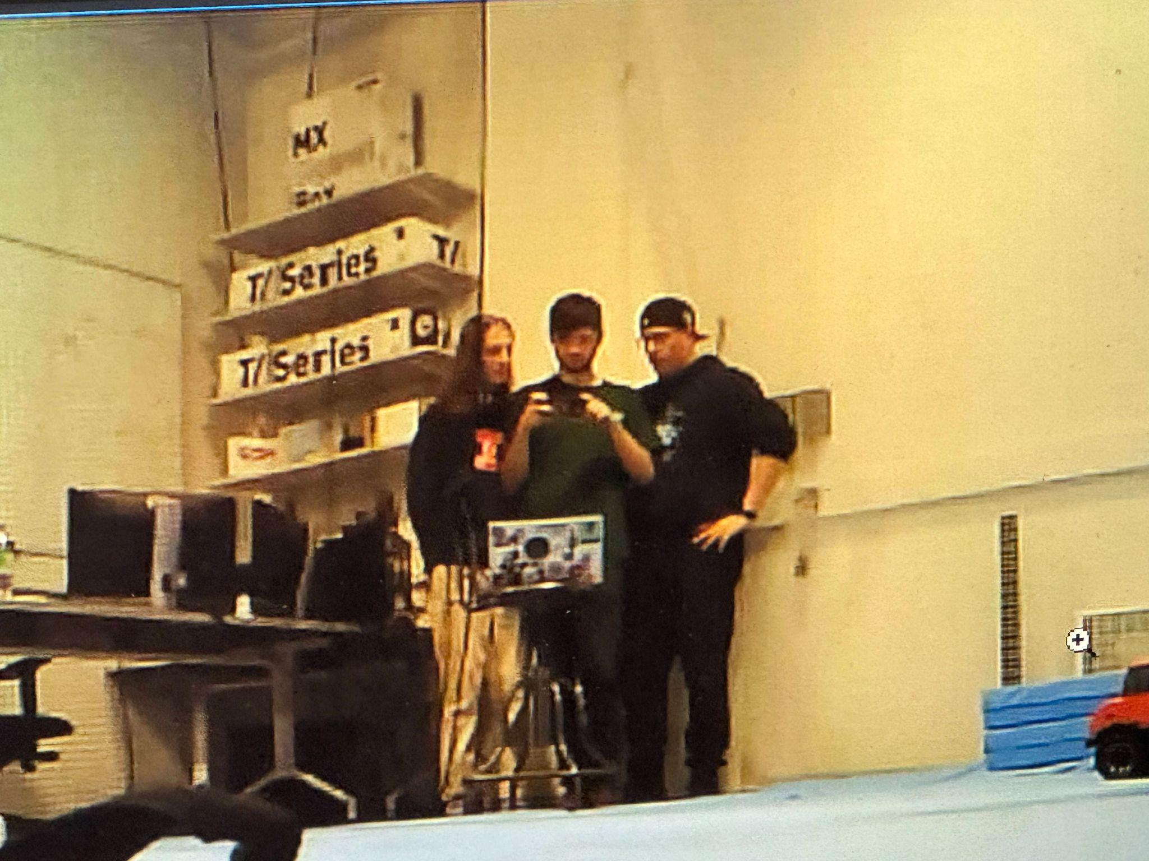
Who are we?
Hunter Baisden
Elias O’Malley
Griffin Descant
Notes:
Everyone introduces themselves in the order on the slide
Griffin Talks about how the image is taken from the drone [next slide]

Slide 3
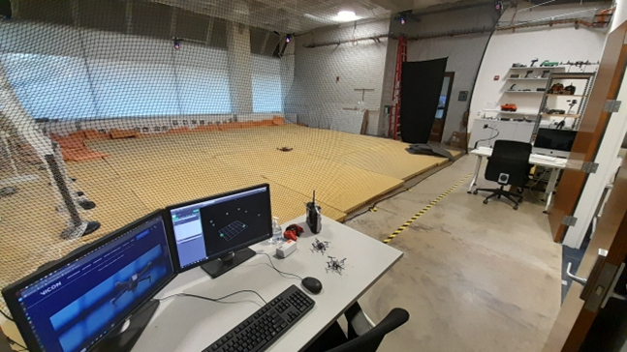
Objective
Our goal is to create a FPV drone that will generate more engagement with drone research by providing students with a unique and exciting flying experience.
The Autonomy Arena
Notes:
Eli: Pitch project with the center for autonomy robotics lab

Slide 4
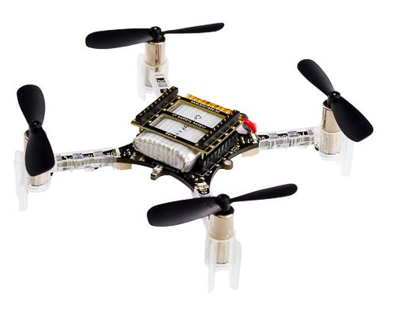
The Crazyflie Drone
The Crazyflie is a lightweight, open source drone used by the lab.
Limitations:
Size
Small battery
A Crazyflie 2.0 Model
Notes:
Hunter
Start with this is the drone given to us by the lab, traditional FPV drones are too large/fast

Slide 5
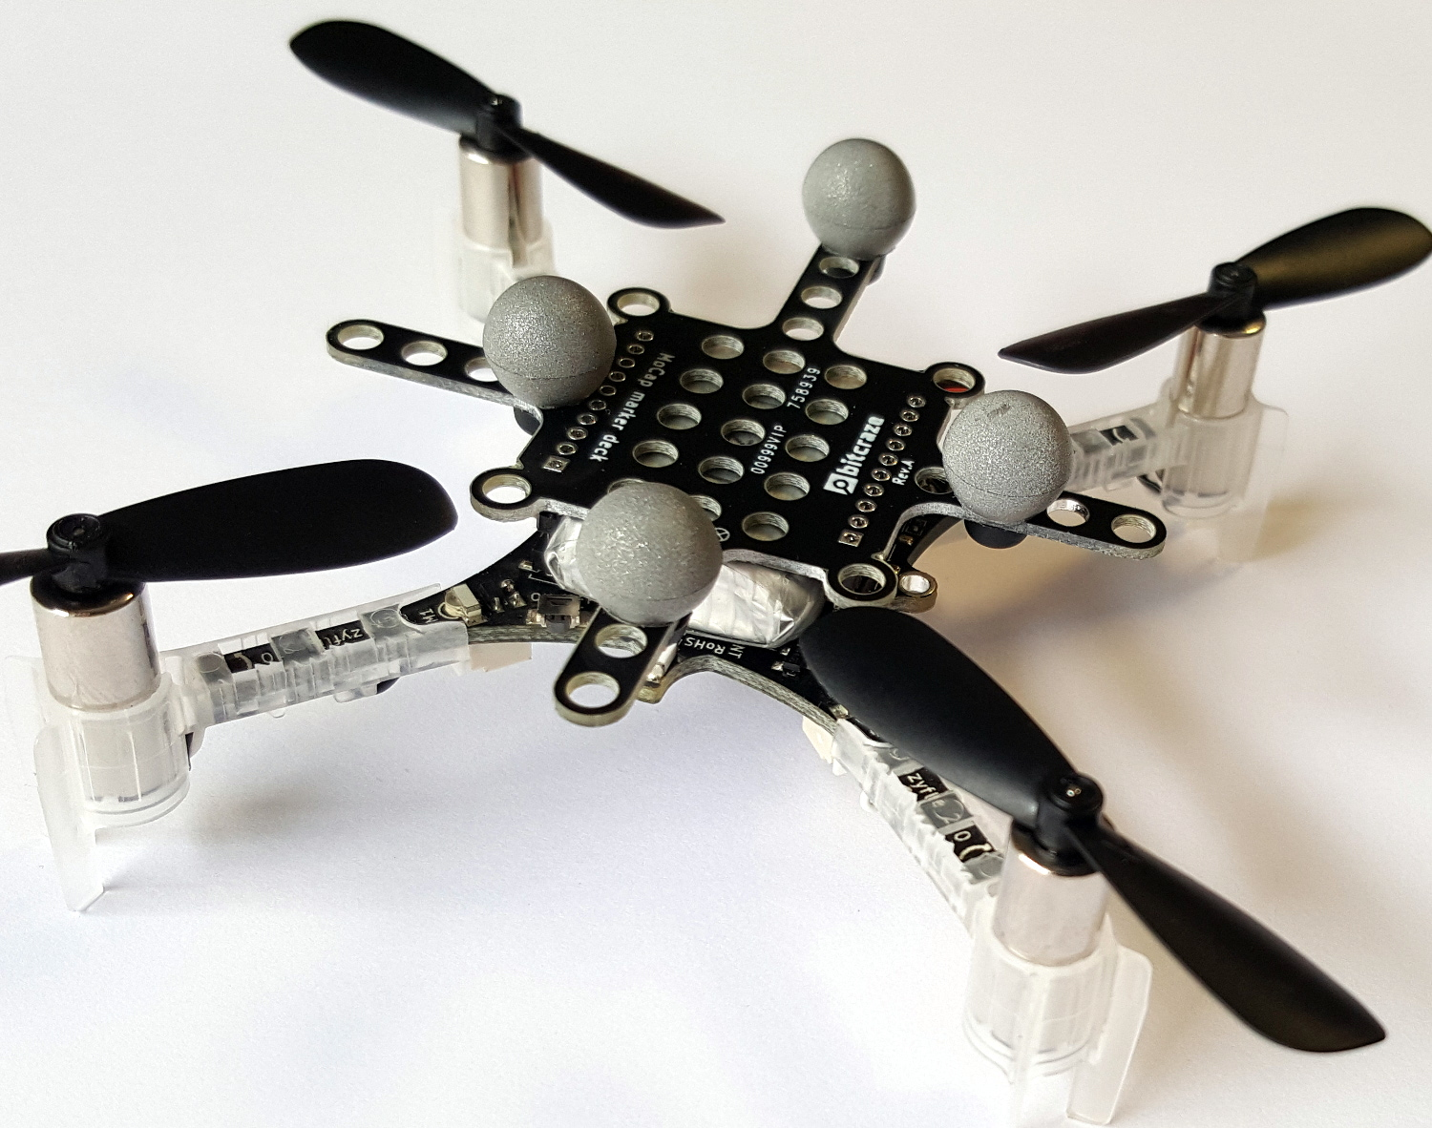
The Vicon Motion Capture System
The flight arena is equipped with a Vicon motion capture system.
The lab wants to be able to track and differentiate multiple drones simultaneously.
Currently, the lab uses retroreflective balls, but we tested IR LED on the drone instead.
A Crazyflie with retroreflective balls
Notes:
Griffin

Slide 6
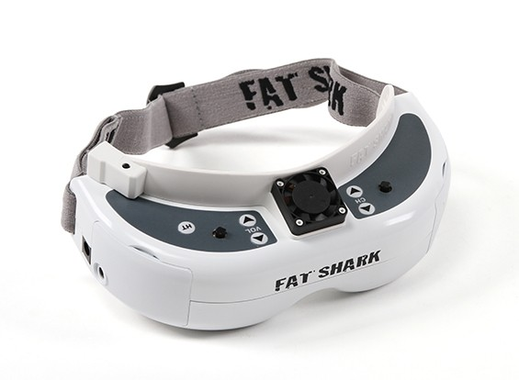
FPV Headset
Fat Shark Dominator V2
Composite video or HDMI input
Notes:
Griffin

Slide 7
High Level Requirements
Stable Flight
<5% deviation from normal flight paths
Balanced
<15g of weight added
Low Latency Video
30 FPS
Minimal interruptions
Vicon System
Track the drone accurately
Test IR LEDs with the system
Notes:
Eli then Hunter then Griffin
Mention why each requirement is important

Slide 8
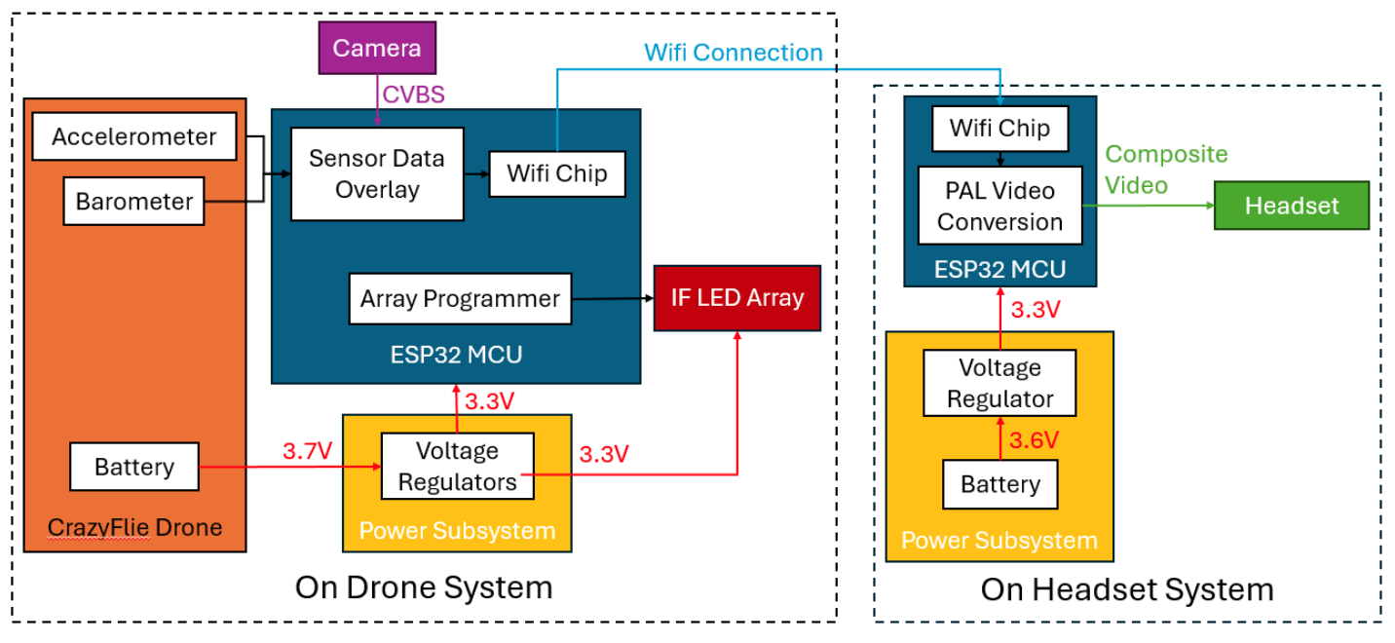
Original Design
Notes:
Eli

Slide 9
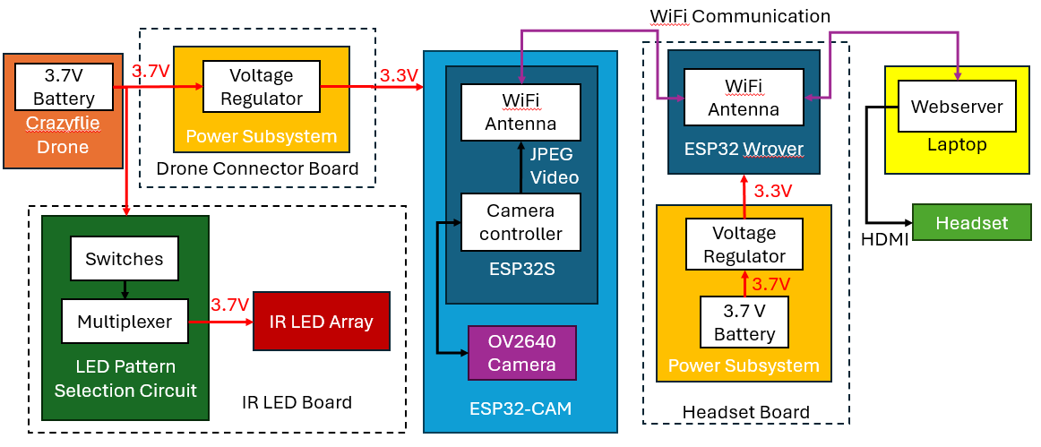
Final Design
Notes:
Eli
What we changed and why we changed it

Slide 10
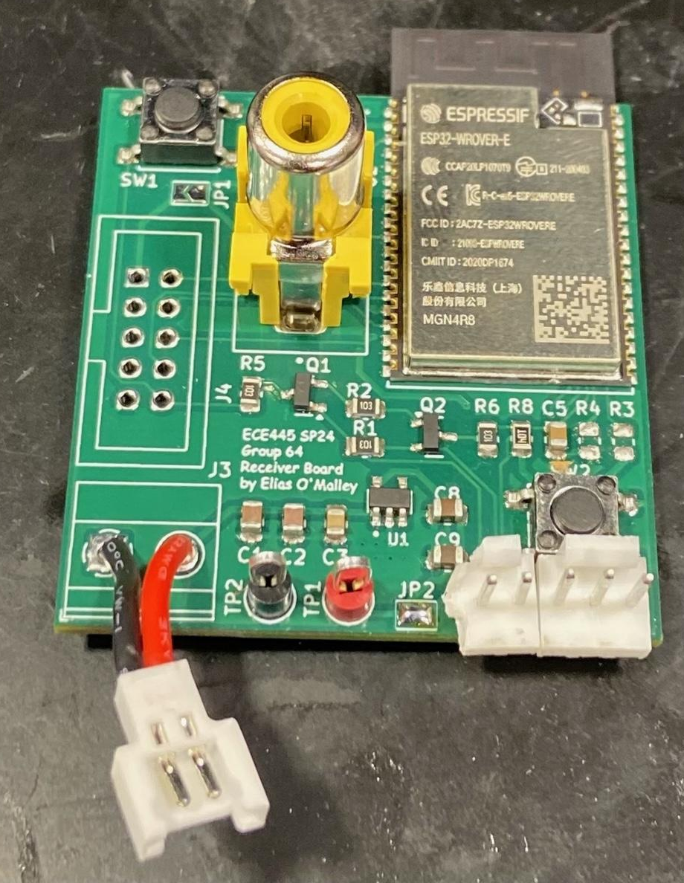
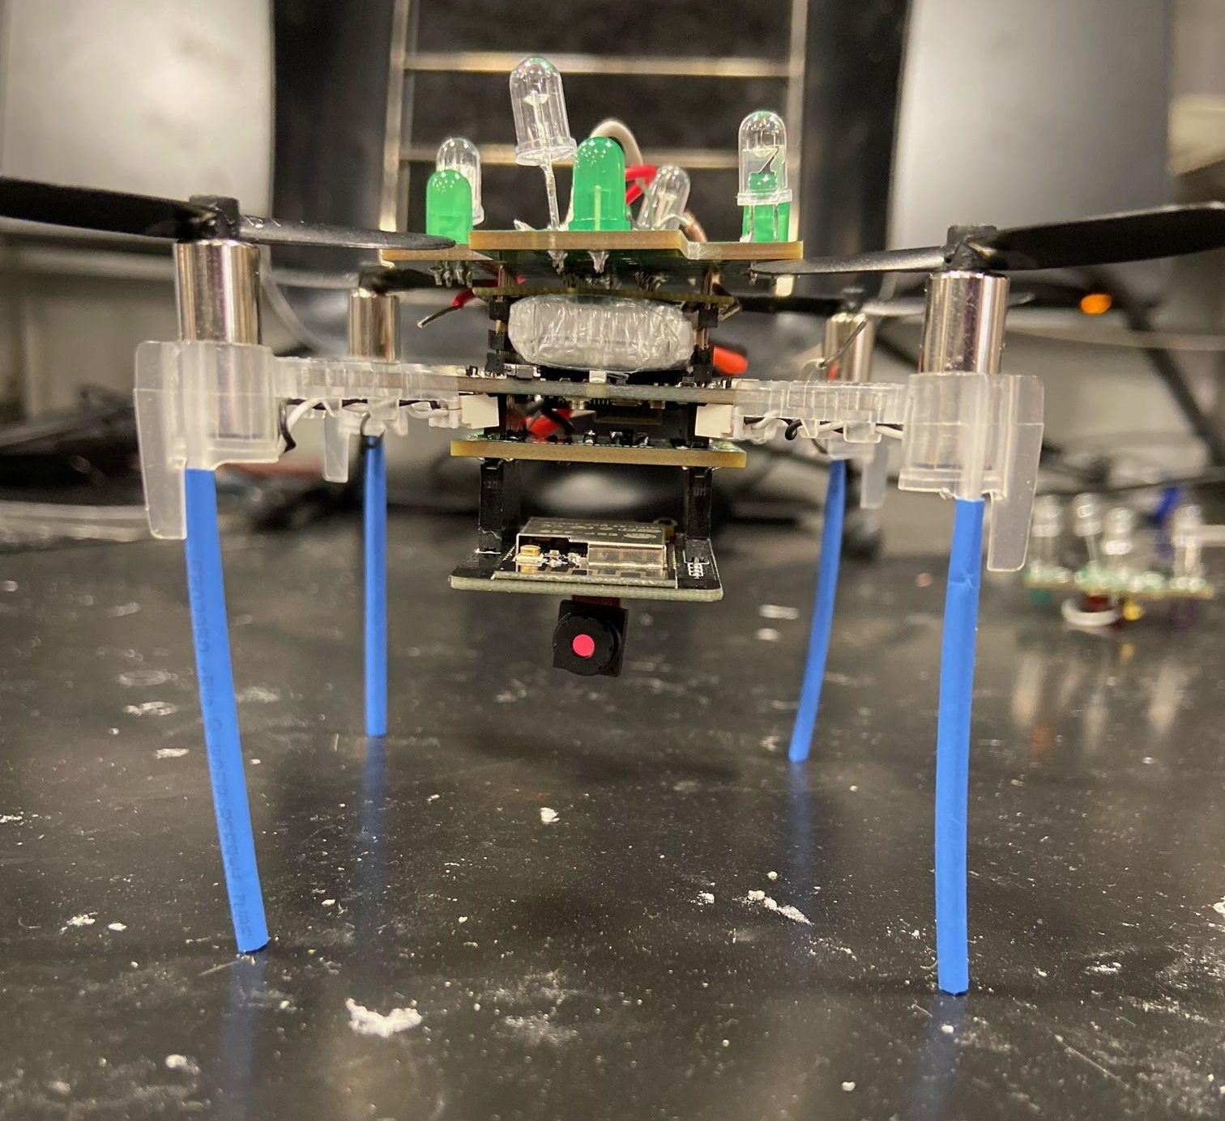
Final Design
Receiver Board
Fully Assembled Drone
Notes:
Griffin
What we changed and why we changed it

Slide 11
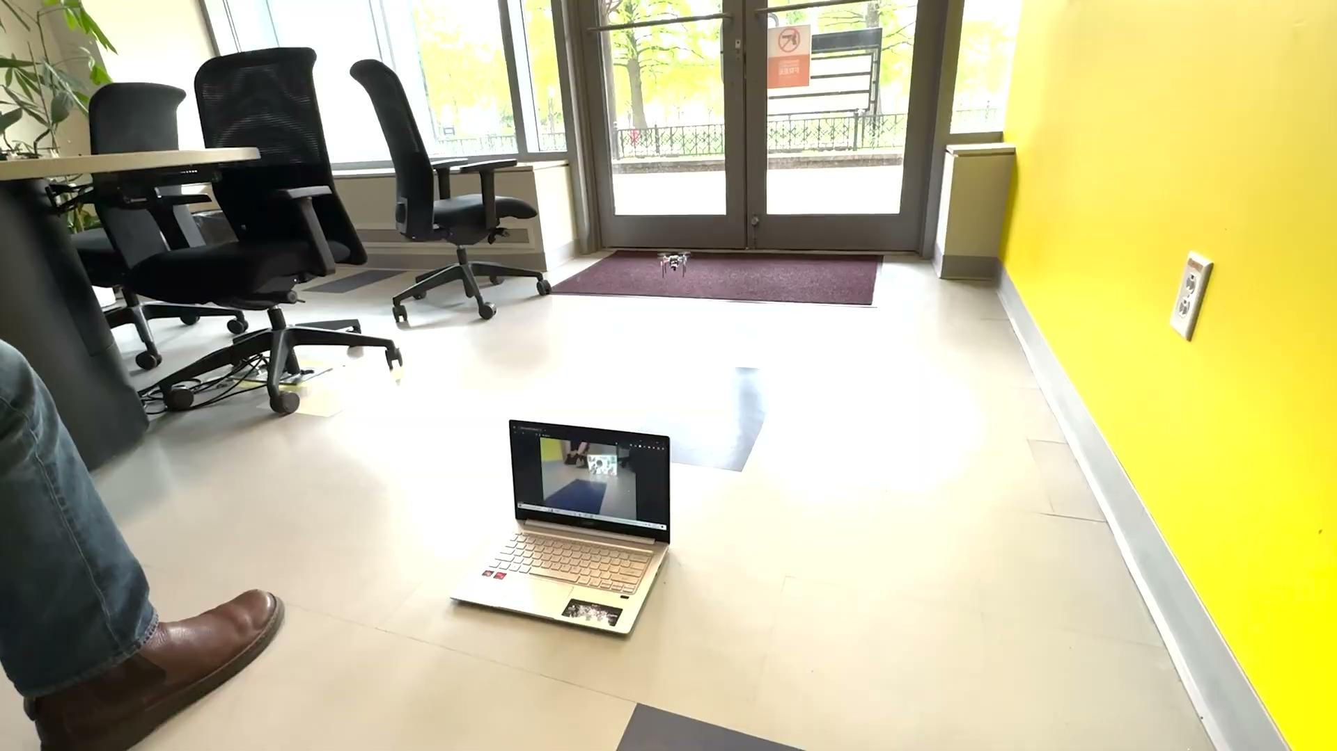
Final Result
Notes:
Griffin - Describe drone flying (increased power to motors), streaming video live, and the benefit of displaying on the computer - allow audience to see

Slide 12
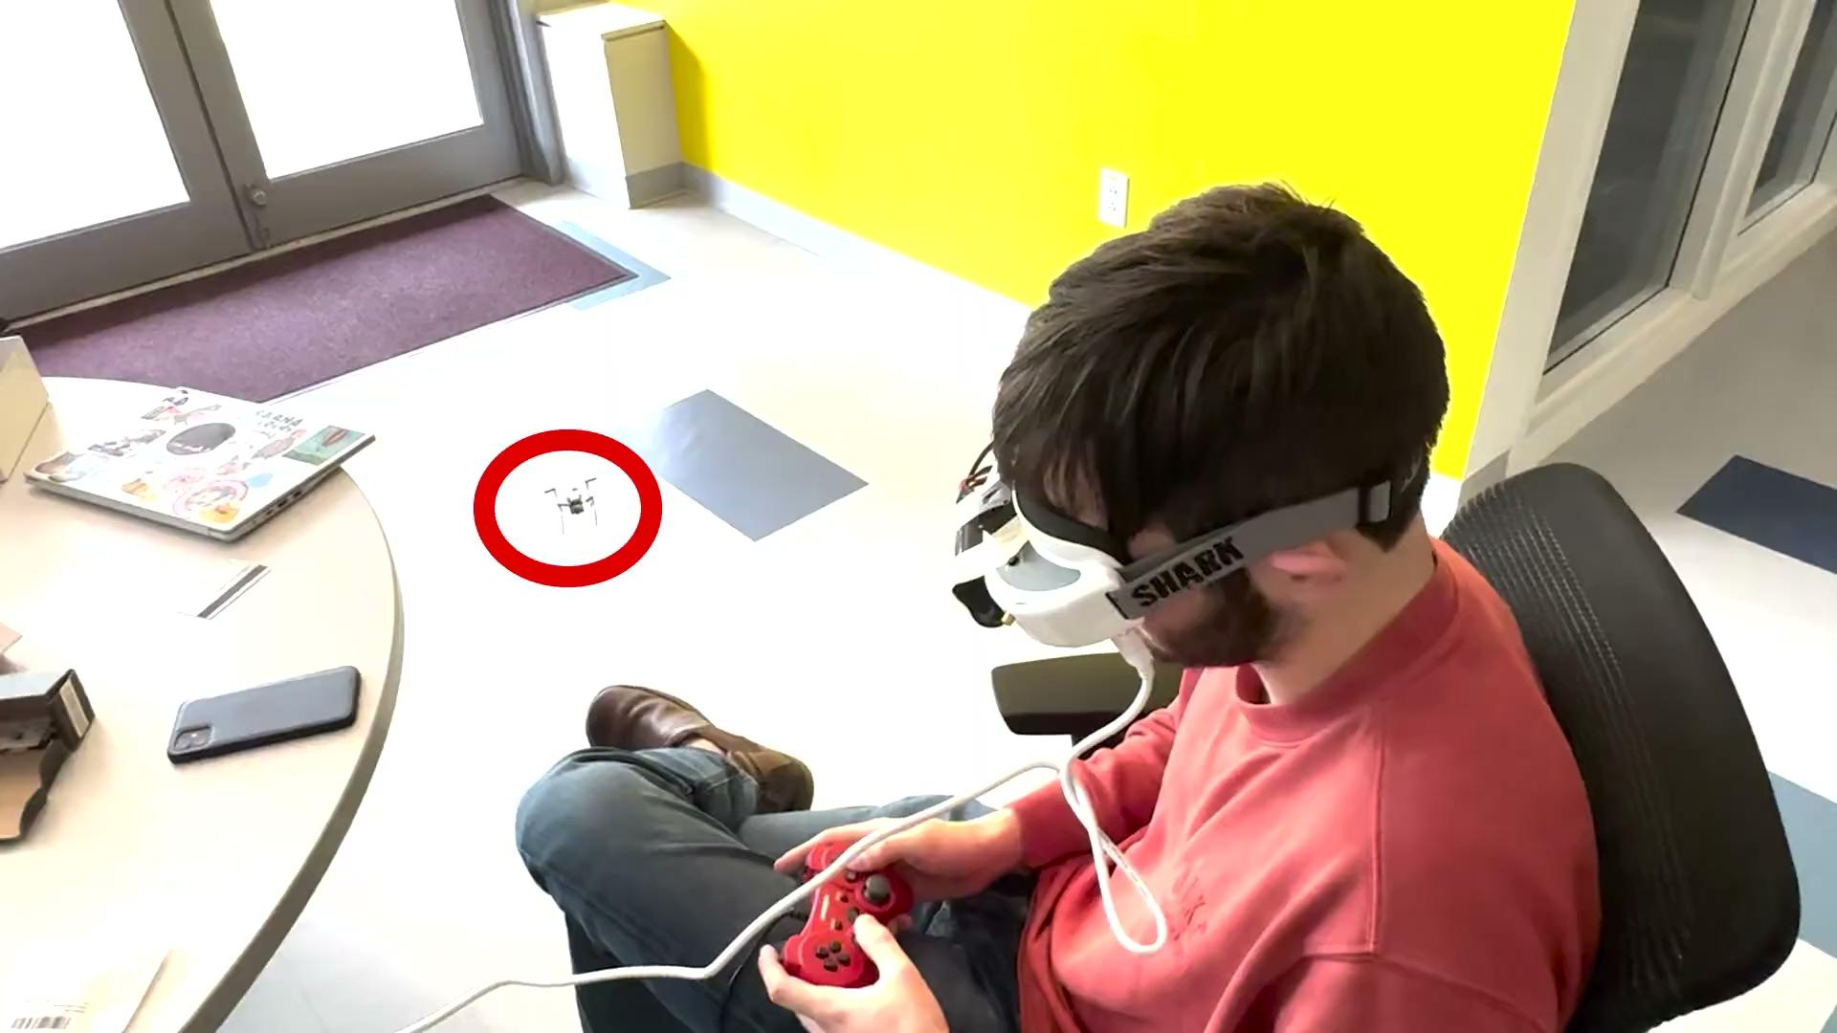
Final Result With Headset
Notes:
Griffin

Slide 13
Drone Flight Verification
Has decent controllability and motion.
Flight Issues:
Slightly lopsided and unstable
A bit slower
These combined to a flight deviation of well over 5%
Additionally, the flight time is ~1 min before the ESP32 CAM browns out
Notes:
Eli
Explain what browning out is (a temporary reduction in supply voltages that causes the ESP32 to reset)

Slide 14
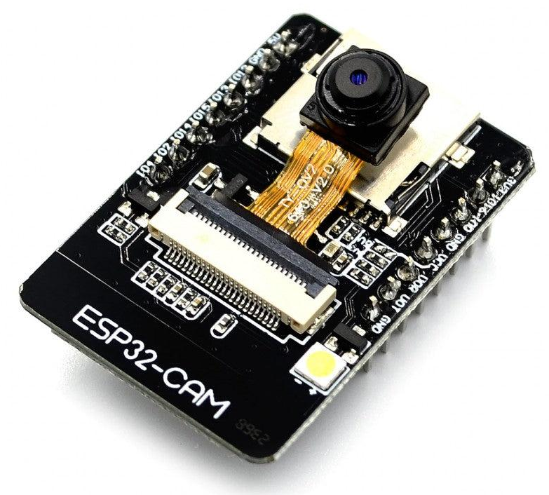
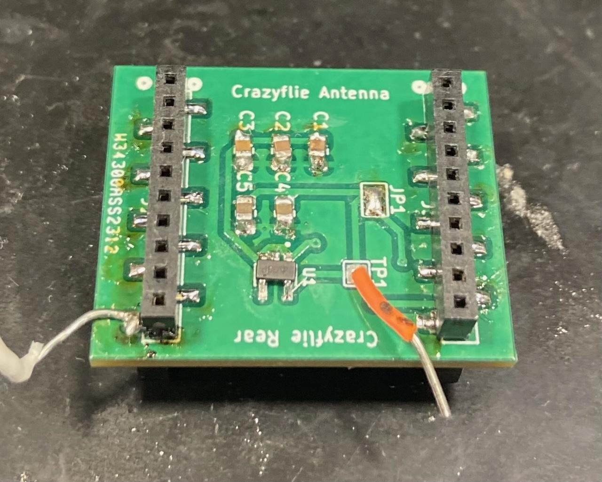
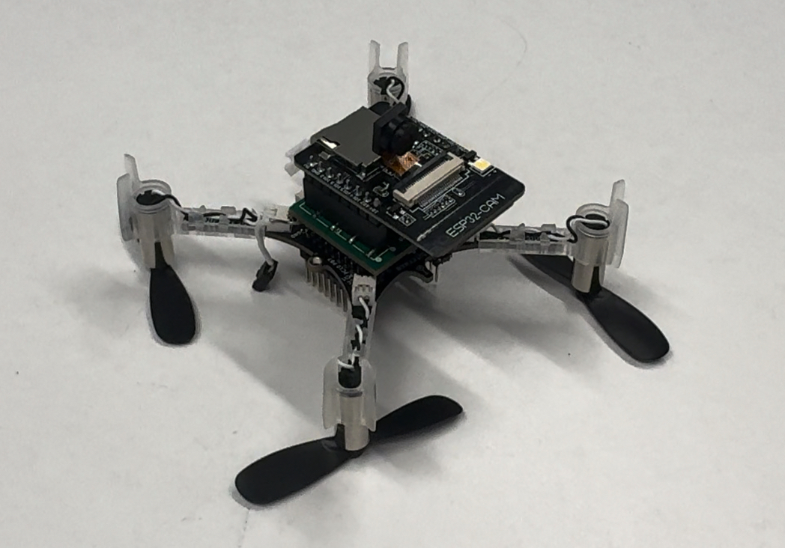
Drone Transmitter Subsystem
+
=
ESP32 CAM
Drone Connector Board
Equipped Crazyflie
Notes:
Hunter
First of the three designed PCBs for this project

Slide 15
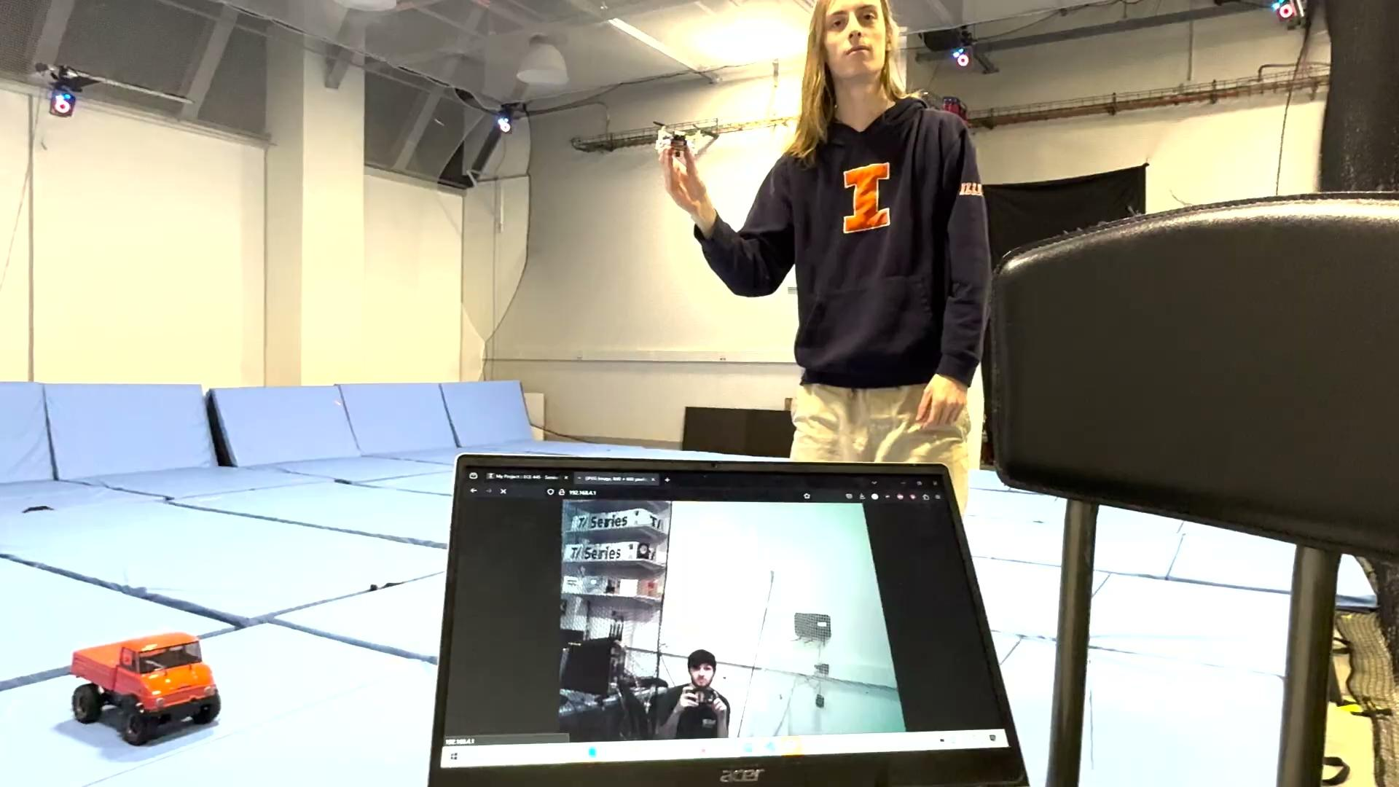
Drone Transmitter Verification
After Frame Analysis in Premiere Pro:
Achieves 30 FPS
Delay of about 160ms
Notes:
Hunter
Talk about where the frame analysis came from and where these numbers came from

Slide 16
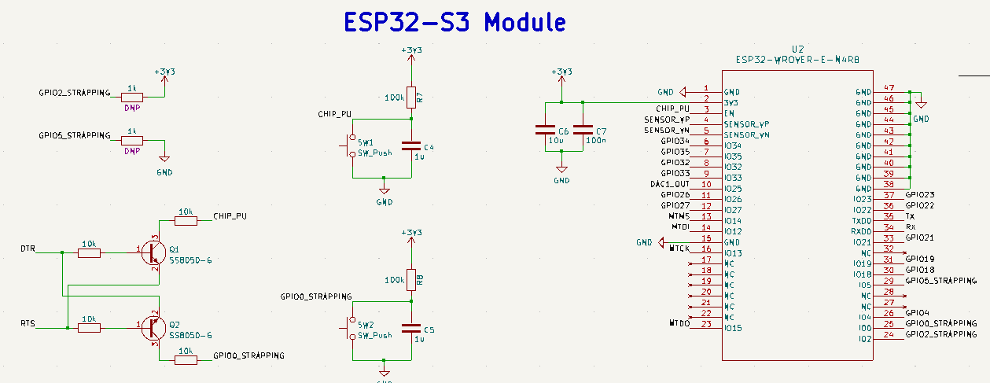
Headset Receiver Subsystem
ESP32 WROVER Chip
Different package
Different GPIO strapping pins
Has two DACs
Was able to create CSV Video
Was not able to convert JPEG Video to CSV
Notes:
Eli
In order to convert a digital video to analog CSV, we required DACs
The more modern and common ESP32 S3s actually removed the DACs, so we used the older ESP32 WROVER

Slide 17
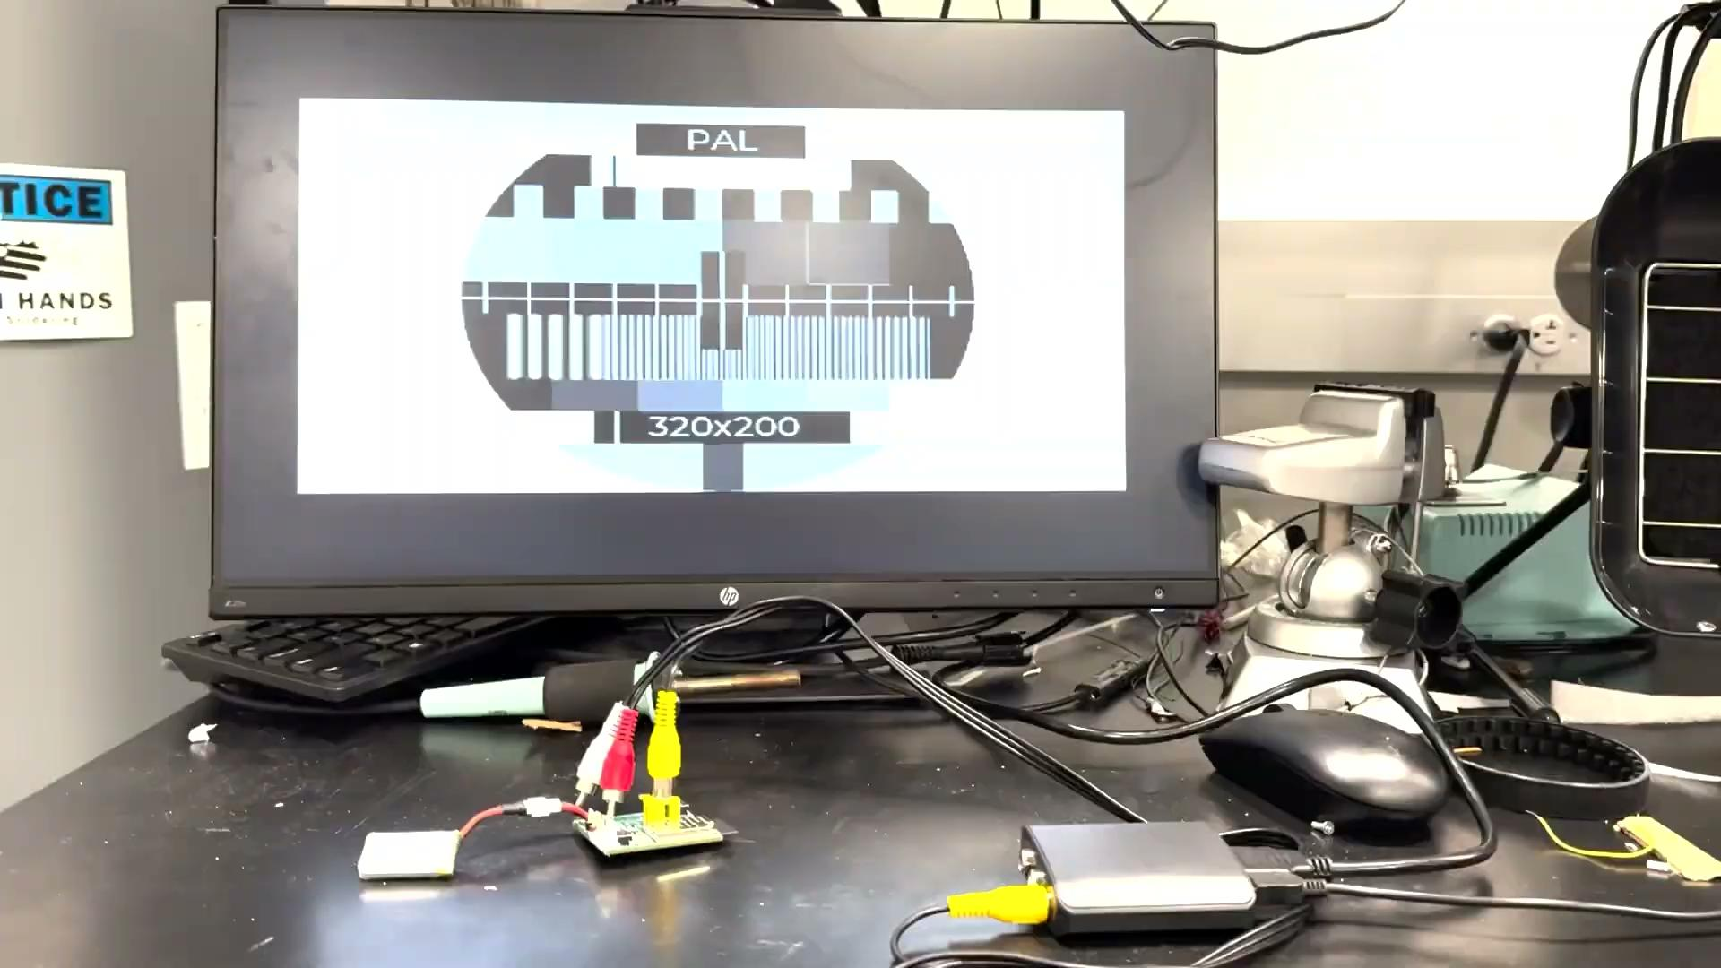
Headset Receiver Verification
CSV output with preloaded video
Notes:
Eli
Show it works with preloaded video
Was unable to generate video from a jpeg video stream
Demonstrates hardware works

Slide 18
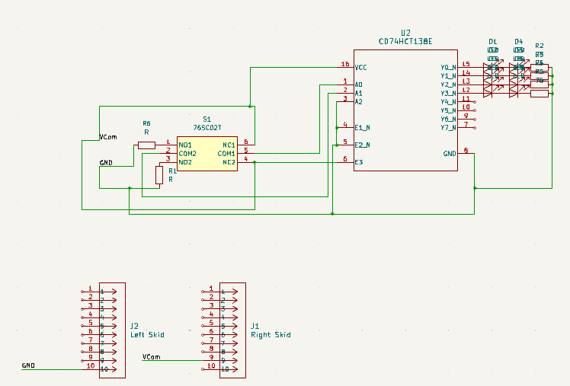
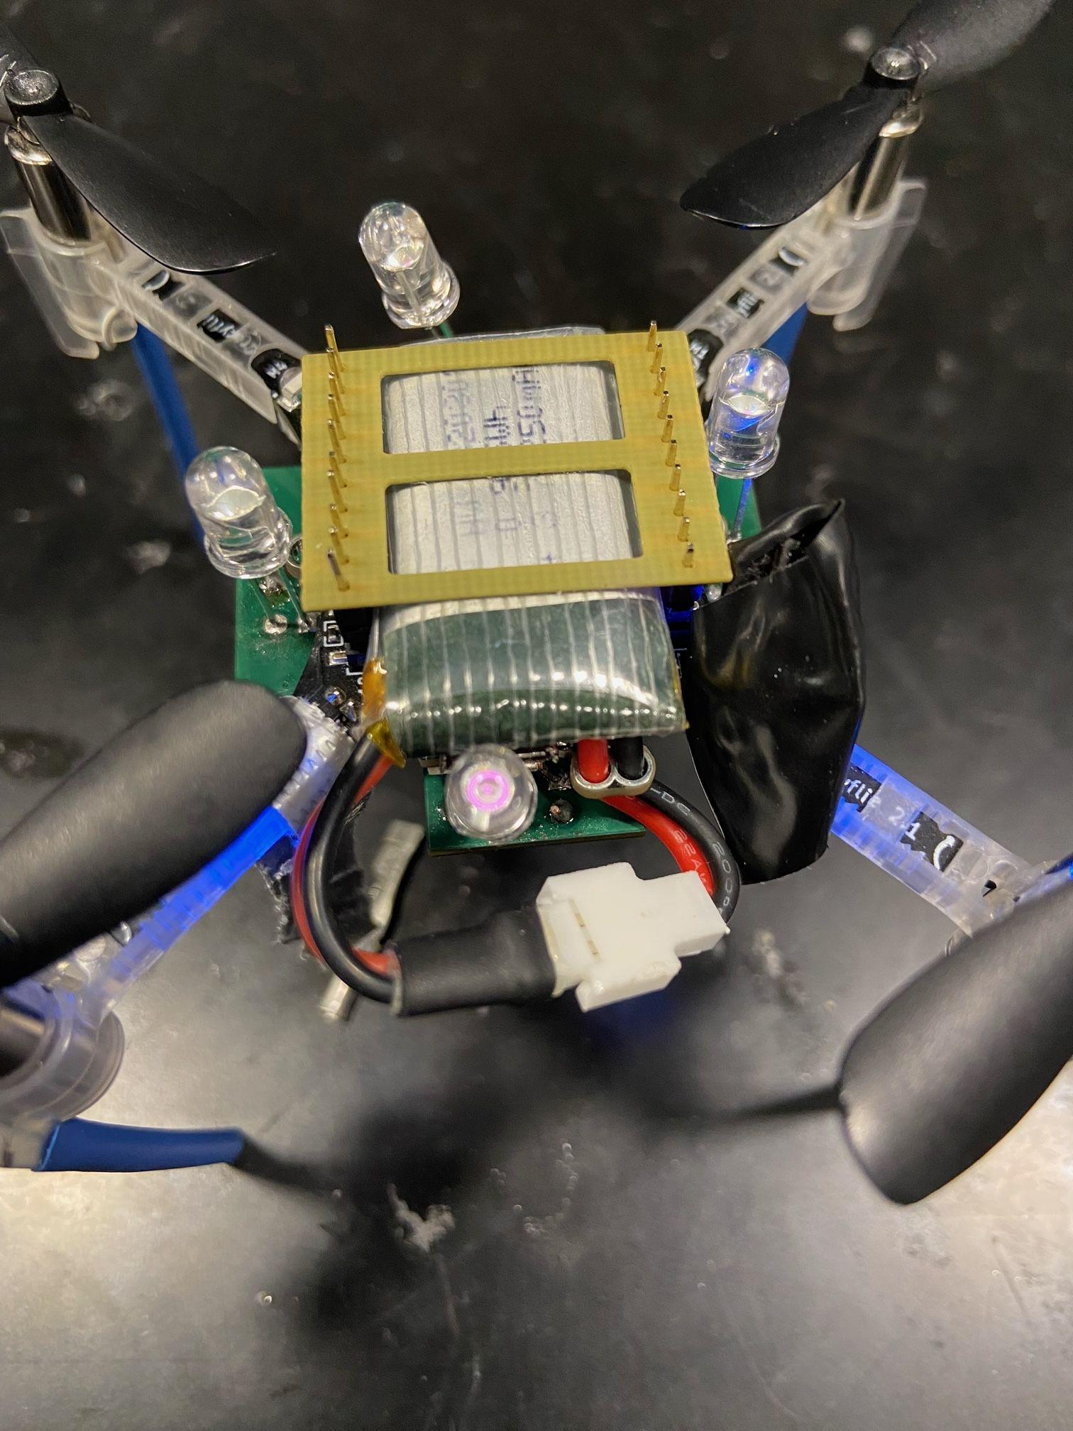
LED and Vicon Subsystem
Notes:
Griffin

Slide 19
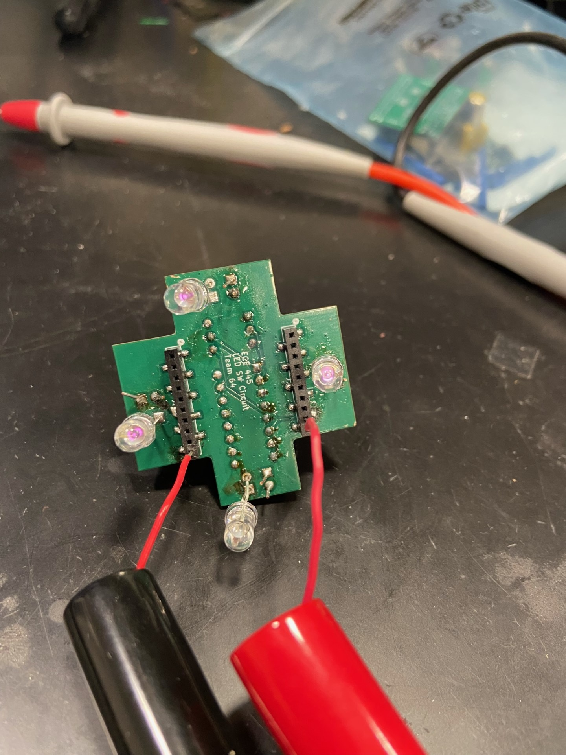
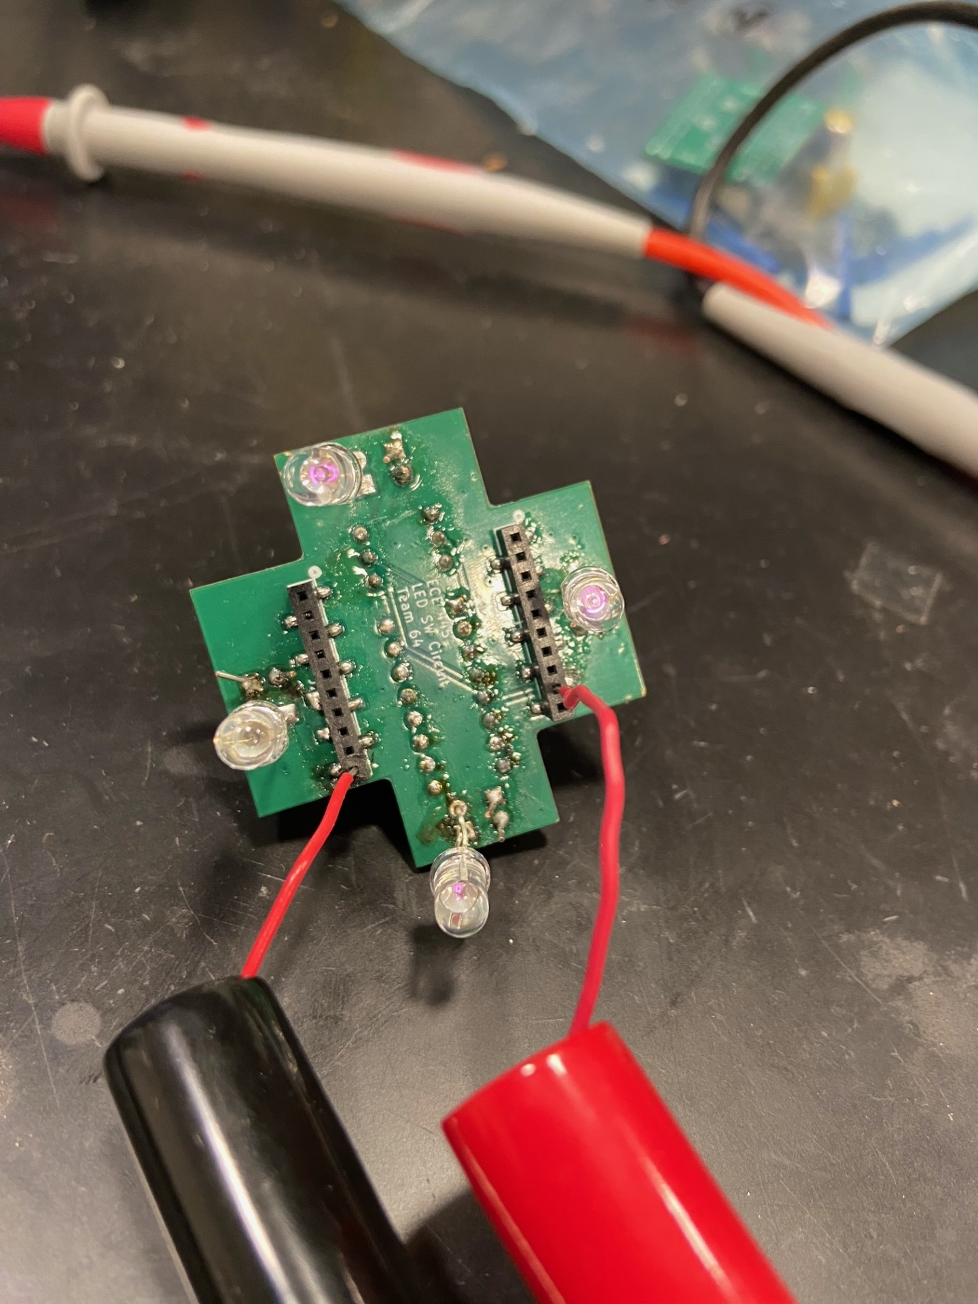
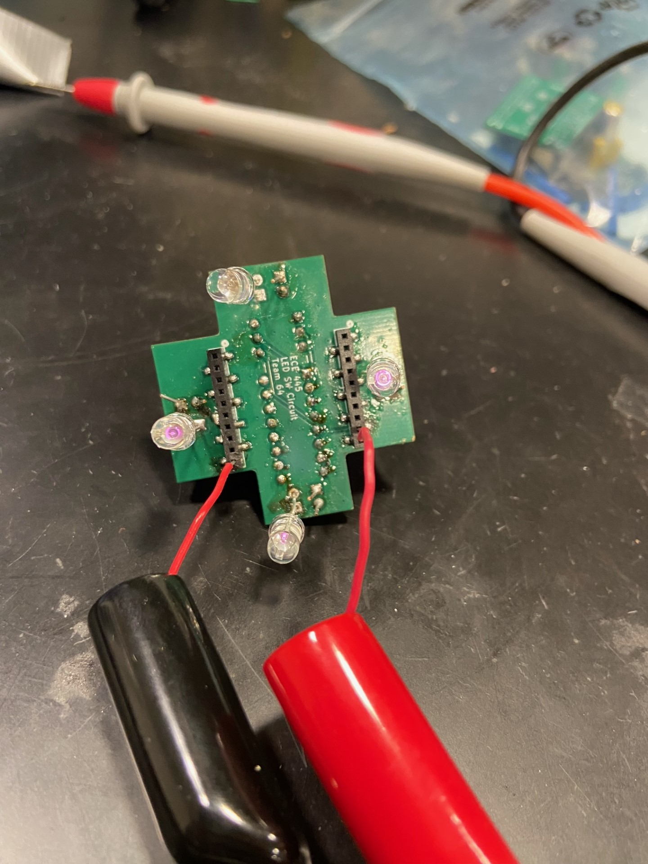
LED and Vicon Verification
Configuration 1
Configuration 2
Configuration 3
Configuration 4
Notes:
Griffin - Say the vicon can’t pick up - transition

Slide 20
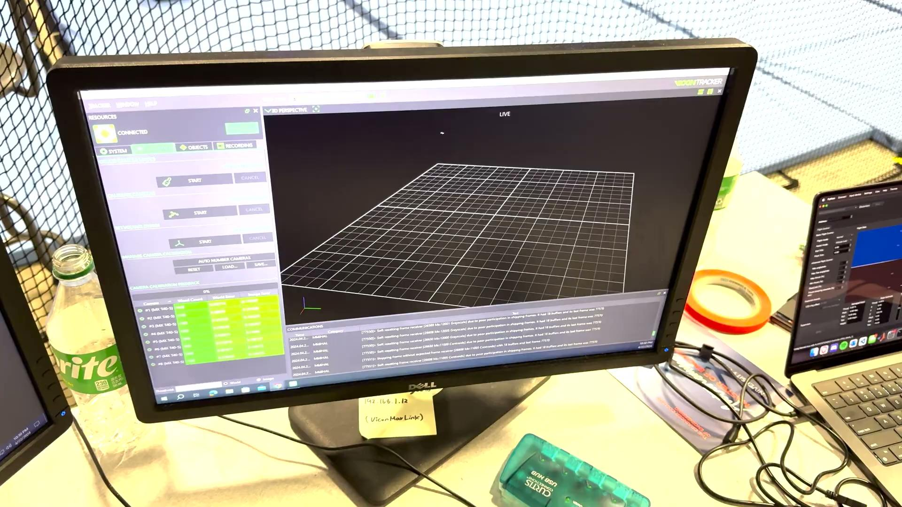
Vicon Verification With Reflective Balls
Notes:
Hunter

Slide 21
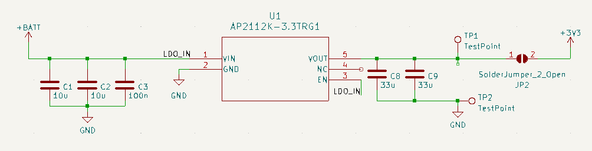
Drone and Headset Power Subsystems
AP2112K LDO
Static 3.3V
600mA
Notes:
Eli

Slide 22
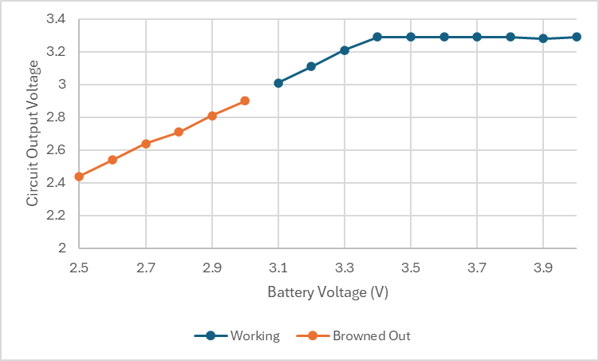
Drone and Headset Power Verification
Notes:
Griffin

Slide 23
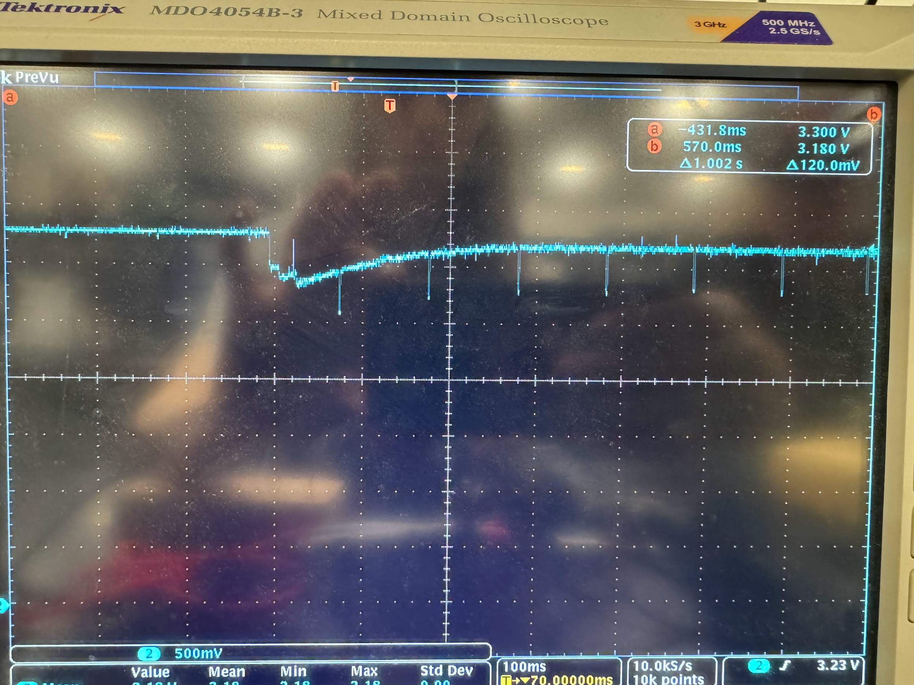
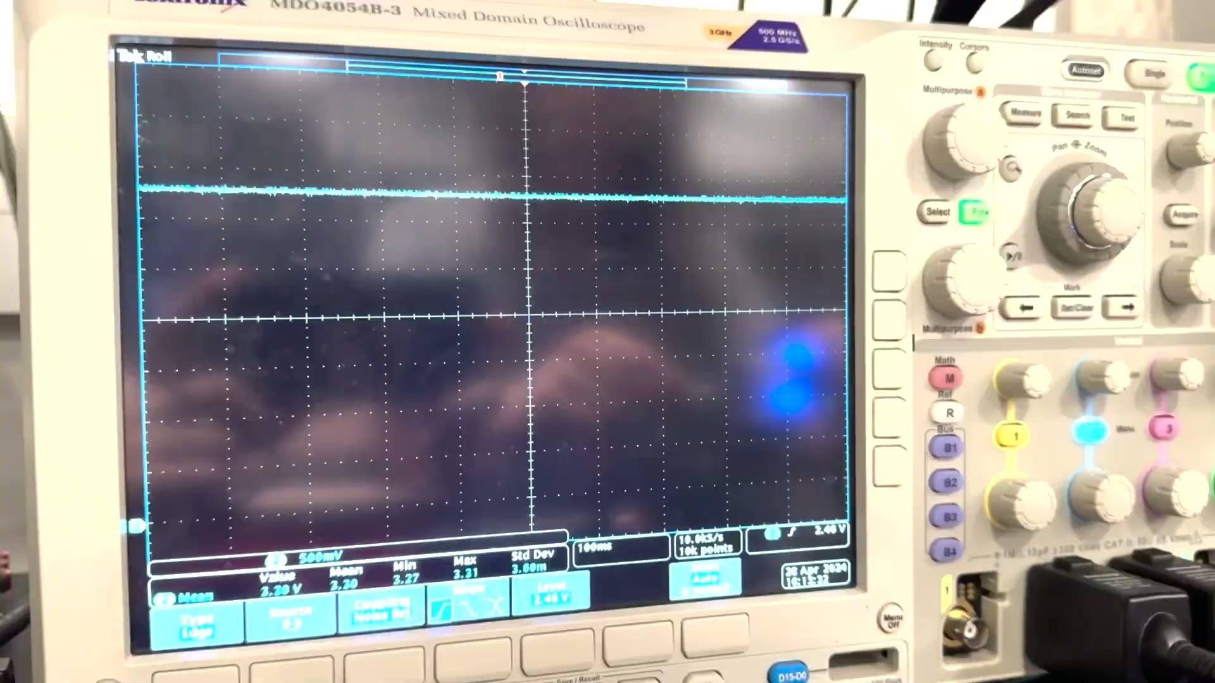
Drone Power Verification
LDO output step due to motor turn on (low battery)
LDO output step due to motor turn on
(high battery)
Notes:
Hunter
440mV drop initially
Steady state 120mV drop
Only when battery is low (25%)

Slide 24
Successes:
Failures:
Drone flies while video is streaming
Video is streamed from camera on drone to FPV Headset
LEDs light up in selectable pattern
Both boards maintain consistent power supply
Board capable of generating composite video signal
Short camera lifetime
Drone does not have full range of motion
LEDs too dim to be detected by Vicon
Use of laptop and HDMI to transmit video from webserver to the headset
Notes:
Eli has successes
Hunter has failures

Slide 25
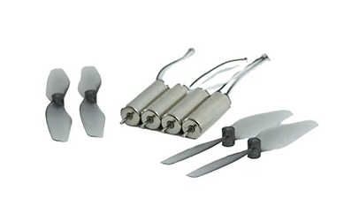
Future optimizations
1) Shave weight:
Design lightweight cam board
Lighter connectors
Half thickness PCB
OR
Crazyflie thrust package
2) Finish JPEG to Composite video conversion code
3) Brighter IR LEDs
Notes:
Griffin takes optimization 1
Eli takes optimization 2
Hunter takes optimization 3

Slide 26
Acknowledgements
John Hart, Principle Research Engineer UIUC Autonomy Labs
Dennis McCann, Aerospace Graduate Research Assistant
Tianxiang Zheng, Electrical and Computer Engineering Graduate Teaching Assistant
Notes:
Griffin

